Slide 1
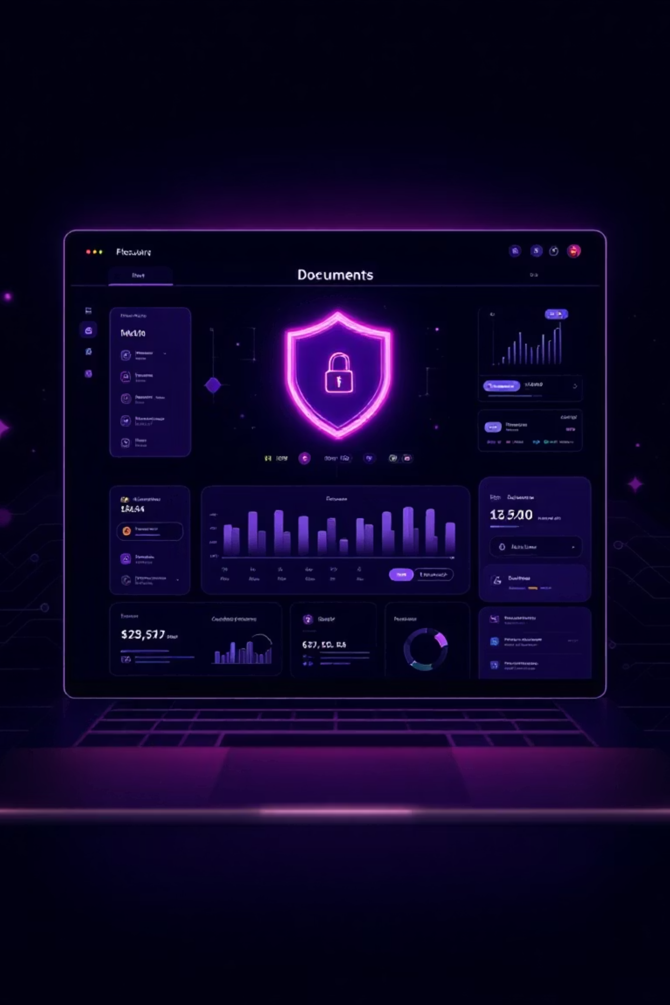

Smart Documentation Hub
A Web Application for Secure Document Management and Real-time Collaboration.
Presented By:-
1. Disha Gaikwad
2. Manas Pawar
3. Saket Deshmukh
4. Abdul Rahman
5. Hridaynath Mandowkar

Slide 2
Problem Statement :
Organizations today struggle with fragmented, static, and outdated documentation systems that fail to meet the demands of modern workflows.
Knowledge is often scattered across multiple platforms, making it difficult for employees to find accurate information quickly. Manual updates lead to inconsistencies, version conflicts, and compliance risks.
Traditional documentation lacks personalization, interactivity, and real‑time collaboration, resulting in wasted time, reduced productivity, and poor decision‑making.
In a fast‑paced digital era, businesses need a smarter, centralized, and adaptive documentation hub that transforms information into a living, accessible, and strategic resource.

Slide 3
Scope :
The scope of the Smart Documentation Hub includes the design and development of a webbased document management platform that supports secure document storage and real-time
collaboration.
The system enables users to upload, organize, edit, and manage documents
through an intuitive and user-friendly interface.
Features such as real-time editing, inline commenting, and version control are implemented to enhance collaborative efficiency and
reduce document conflicts.
The platform incorporates secure user authentication and role-based access control to restrict
document access according to assigned user roles.
Controlled document sharing is supported to allow authorized users to access selected documents while maintaining data privacy and security.

Slide 4

Introduction :
In today’s fast-paced digital world, documents are created, shared, and revised at an unprecedented rate. However, traditional methods of document handling often lead to significant inefficiencies and risks.
Version conflicts: Multiple authors lead to conflicting document versions.
Duplication: Redundant files waste storage and create confusion.
Security issues: Lack of centralized control exposes sensitive information.
Collaboration overhead: Manual processes hinder efficient teamwork.
There is a clear and urgent need for a secure, streamlined, and collaborative document management system to overcome these challenges.
With the increasing use of digital documents, managing them securely and collaboratively has become challenging. Smart Documentation Hub addresses these issues by providing a centralized and real-time document management solution

Slide 5

Version control to track changes
Real-time editing and collaboration
Version control to track changes
What is Smart Documentation Hub?
Smart Documentation Hub is a centralized web platform that allows users to securely store documents and collaborate on them in real time. It supports features like version control, access management, and real-time editing, making document handling more efficient and secure.
Centralized Platform
A unified hub designed to streamline document creation, management, and real-time editing and collabration.
Seamless Integration
Seamless Integration refers to the ability of the Smart Documentation Hub to work smoothly with existing systems and workflows without disruption.

Slide 6




Key Features :
Real-time Collaboration
Centralized Document Storage
Role-Based Access Control
Simultaneous editing with robust version control and comprehensive audit trails ensures transparency and accountability.
All
documents stored
and managed
in one
secure
Platform.
Ensures documents
are
accessed
only by authorized users.

Slide 7
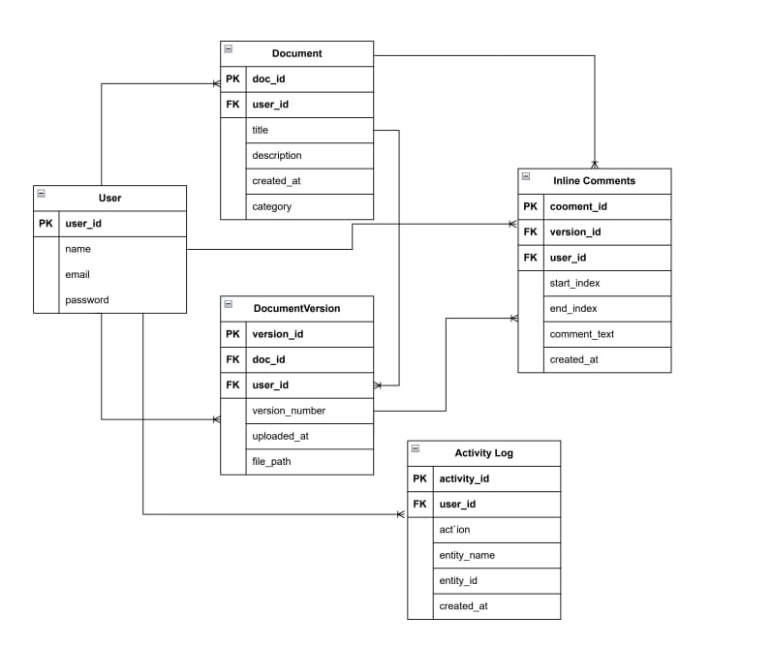
ER Diagram :

Slide 8
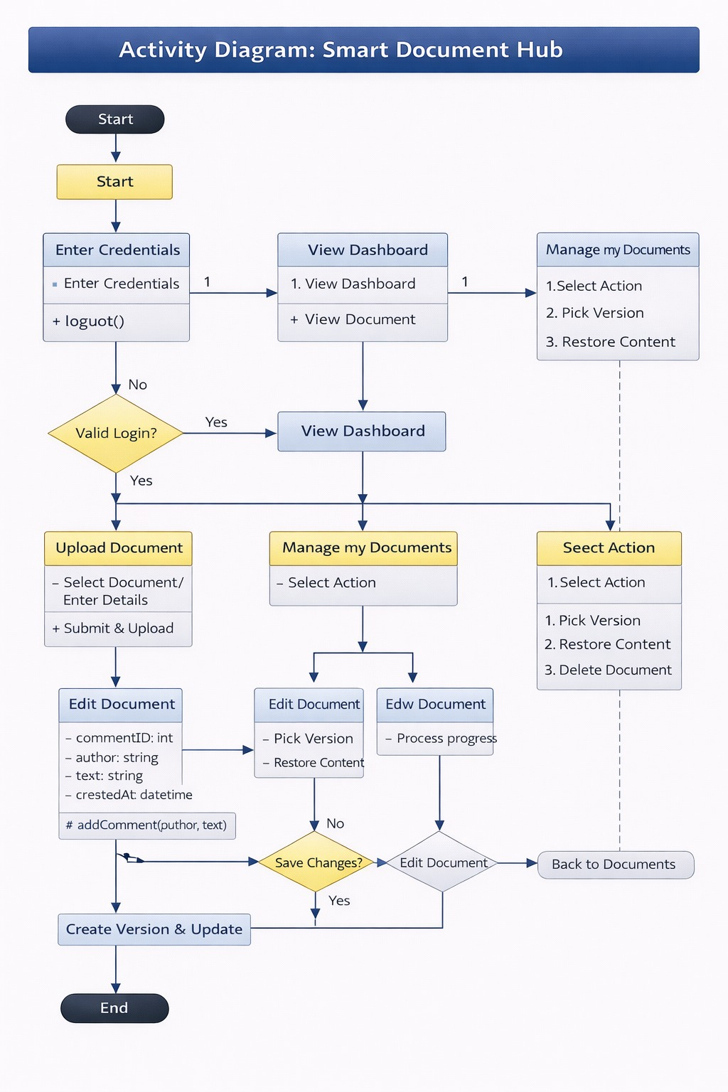
Activity Diagram :

Slide 9

Real-World Impact: Case Study Snapshot
The Smart Documentation Hub delivers tangible benefits across various industries, proven by measurable results.
40%
25%
100%
Reduced Documentation Time
Faster Resolution Times
Improved Audit Readiness
A tech startup achieved a significant reduction in documentation efforts within just three months.
Customer support teams leveraged instant document retrieval to cut resolution times.
Compliance teams experienced full audit readiness with automated version tracking and historical data.

Slide 10

Outcomes & Future Enhancements :
Key Outcomes :
Improved Efficiency – Faster access to accurate information reduces time wasted searching across scattered sources.
Enhanced Collaboration – Real‑time updates and version control ensure teams work seamlessly on shared documents.
Consistency & Accuracy – Automated workflows eliminate errors and maintain compliance across all documentation.

Slide 11

The Future of Documentation is Here
Documentation is evolving from static files to dynamic, intelligent hubs
Collaboration becomes seamless with real‑time updates and version control.
Automation reduces manual effort, ensuring accuracy and consistency.
Personalized experiences adapt content to user roles and needs.
Interactive formats replace lengthy text with clarity and engagement.
Knowledge is centralized, accessible anytime, anywhere.
Security and compliance are built into every layer of documentation.
Continuous learning keeps documentation alive and future‑ready.

Slide 12
Conclusion :
In summary, the Smart Documentation Hub stands as a premier solution for modern document management.
The future of documentation is not just about storing information, it is about empowering people with intelligent, accessible, and adaptive knowledge. Smart documentation hubs redefine the way organizations create, manage, and share insights—turning every document into a living, collaborative resource. By combining automation, personalization, and security, they ensure that knowledge flows seamlessly across teams and evolves with changing needs. This transformation positions documentation as a driver of innovation and efficiency, making it a true strategic advantage in the digital era.
Collaborative & Intiative
Designed to foster seamless teamwork and user-friendly interaction.

Slide 13
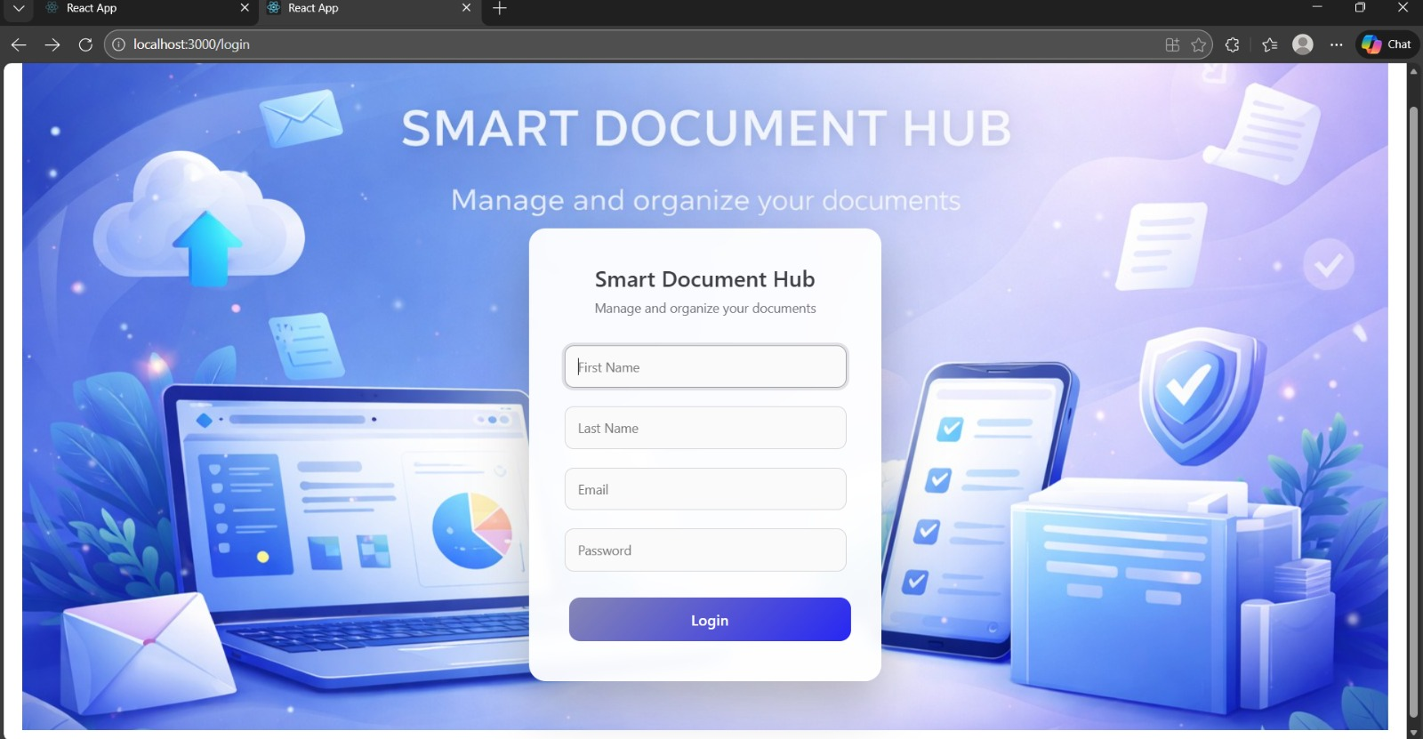
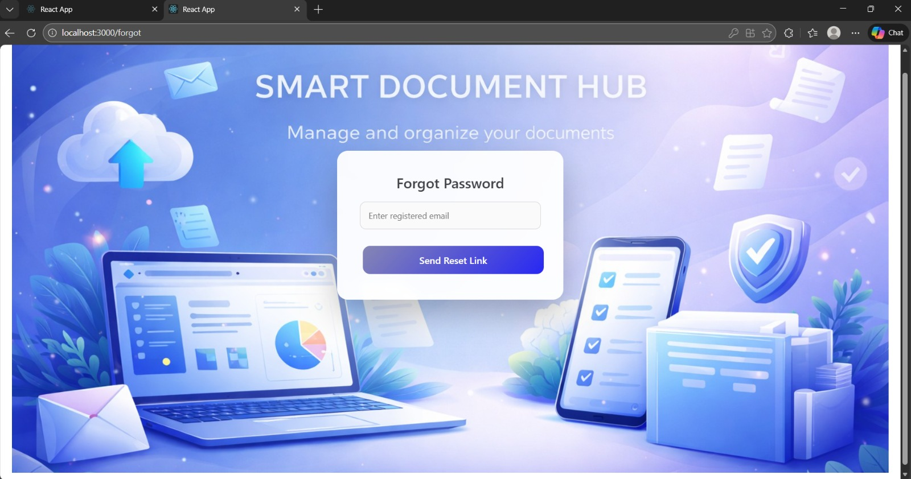
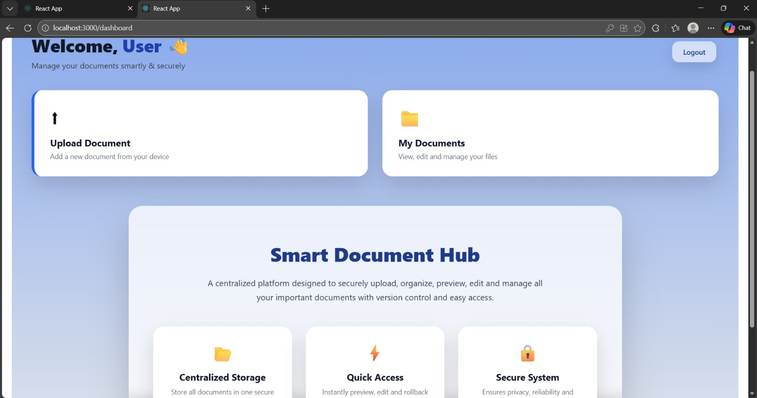
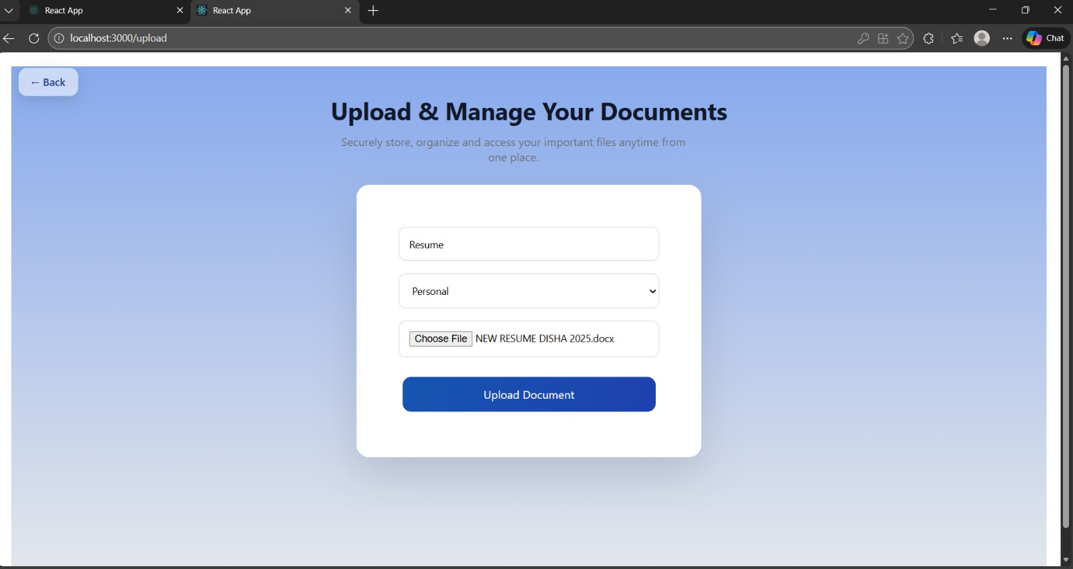
Screenshots :

Slide 14
Thank You…!
Thank you for your attention.
I am now happy to answer any questions you may have.

